Slide 1
Metaphor: Fate is like a ___________________________.
The parameters are fixed towards a final outcome.
Because they are human, all mortals have limited vision.
Aristotle believed that being who you are, in a culture or situation that constrains you, prevents you from understanding the information at hand.
What detail of the Shepherd’s story gives Oedipus hope that the prophecy isn’t true?
Recall 2 reasons why the witness may have lied.
Insert an image of a robber

Slide 2
The Moment of Truth
How do the strophe and antistrophe present two different viewpoints about the relationship between the gods and humanity?
Strophe: The chorus seems ________________ that the gods will ___________________ the haughty (prideful) and the lawless.
Antistrophe: The chorus seems ________________ about divine fulfillment of oracles and declares that its members _________________in traditional worship if the gods fail them.
Word Bank: (verbs) (adjectives)
Strike down Pessimistic
Can’t participate Confident

Slide 3
How do you think this ode may have affected the audience?
The audience must shift their understanding to ________ ___________. Instead of __________ for Oedipus, they support the _____________ _________________.
**This message would be applied implicitly in their real lives.**
Fate--noun
Inevitable--adjective
Sympathy—adjective
Accept—verb
Outcome--noun

Slide 4
Travel in antiquity was a risky ______________. No police force patrolled the open road; people usually journeyed in groups for mutual protection. _____________________ travelers were responsible for their own safety and prepared accordingly. Chance meetings between armed and wary strangers escalated into violence; thus, salutes and handshakes evolved as signals of peaceful intent. However, no such gesture ________________ the quarrel of Oedipus and Laius, an event that was ironic, fatal, and tragic—but not rare.
Insert an image for your favorite transportation. ☺
Using context clues, building vocabulary, find a synonym for each word. Remember, you can replace the synonym in the sentence.
Proposition—proposal, adventure, endeavor
Solitary--alone
Wary—attentive / cautious
Forestalled--prevent

Slide 5
Motive
Answers the question _____?
Revealed by a character’s _____, _____, _____, and _____.
Character’s may not be _____ of themselves.
The gradual revelation builds _____--a feeling of tension or _____--as Oedipus _____ pursues the knowledge that will ultimately bring his _____.
Suspense (n.) thoughts (n.) uncertainty (n.) relentlessly (adv.)
Downfall (n.) aware (adj.) words (n.)
Feelings (n.) actions (n.) why (*)
Insert an image that represents awareness, insight, understanding, realization. This is *abstract.* Delete this box.

Slide 6
FREUD, the “Father of Psychology.”
Insert an image of dreams
Sigmund Freud made the Oedipus complex a well-known phenomenon. So famous is the Oedipus complex that many people have heard about it but have never read what Freud himself wrote. Here is an excerpt from The Interpretation of Dreams, written in 1899:
“The action of the play consists in nothing other than the process of revealing, with cunning delays and ever-mounting excitement, a process that can be likened to the work of a psychoanalysis—that Oedipus himself is the murderer of Laius, but further that he is the son of the murdered man and of Jocasta.”
Freud goes on to say that the play is known as a “tragedy of destiny” that moves the audience because the supreme will of the gods thwarts (prevent /block) mankind’s vain (futile) attempts to escape evil and suffering. (THEME)
The attraction of a girl to her father and rivalry with her mother, is sometimes called the _____________.

Slide 7
Situational Irony
Jocasta is now convinced that divine oracles are _____. Ironically, a few moments earlier, she seemed _____ and respectful toward the gods.
Dramatic Irony
Oedipus’ lighthearted _____ of the oracles is dramatically ironic because we know, in fact, that the prophecies have been _____.
Reverent (adj.) mockery (n.)
Invalid (adj.) fulfilled (verb)

Slide 8
What news does the Messenger bring from Corinth?
Characterization: The Messenger is _____, and though respectful to Oedipus, he is not _____ as one might be in the company of a king.
Reticent—hesitant, reluctant
Inquisitive—curious, questioning
Get an image of something that represents a message (cell phone texts, letters, signs, Amazon box, post-its).
What might the Messenger seek from Oedipus in exchange for his “good news?”
How does Oedipus address the Messenger?
Does this title align with the hard work of running in the role as a messenger? YES / NO. Why?

Slide 9
Where was the infant Oedipus found?
Oedipus means “swollen foot.”
Get an image of a scar.
Dramatic Irony adds to the Suspense:
The audience knows that Laius and Jocasta _____ Oedipus’ ankles together and _____ him on the mountainside to die because of the prophecy. This knowledge increases _____ as the audience watches Oedipus come one step nearer to the truth about his own _____.
Exposed (v.) identity (n.)
Suspense (n.) pinned (v.)

Slide 10
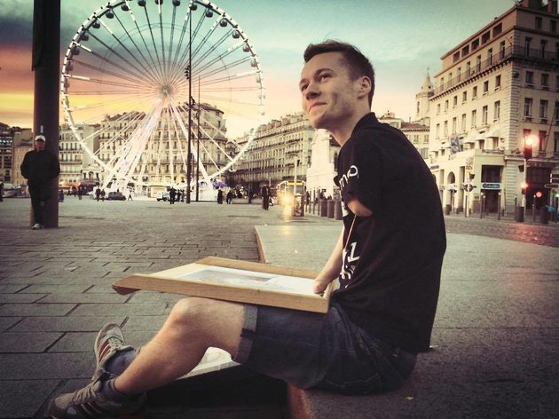
Injury and Irony
http://www.huffingtonpost.com/entry/mariusz-k%C4%99dzierski-artist-no-arms-portraits_us_56b1014ee4b0fbfdd6157b37
http://en.newsner.com/19-year-old-madeleine-is-the-worlds-first-supermodel-with-down-syndrome/about/gender-en,wow
It was Oedipus’ fate to bear a name that proclaimed his injury to the world: “Here comes Big-Foot.” Oedipus’ old injury poses interesting questions for actors playing the role: Should Oedipus limp? Use a cane? Wear orthopedic sandals? However a production may allude to Oedipus’ childhood injury, there is no denying the stunning ironies it produces in the drama. According to the legend, it is a grazing injury to Oedipus’ much-abused foot that precipitates the violent quarrel at the crossroads. With his walking staff, Oedipus kills the very man who maimed his feet. The poor Sphinx poses a riddle of human locomotion to a man exquisitely attuned by injury to the details of crawling, walking, and using a cane. In the end, blindness will put Oedipus on “three legs,” using a staff—perhaps the same that murdered Laius—although he is in the prime of life. (p. 506)

Slide 11
Achievement
Picture of the person
Name
Disability
Achievement
Website

