Slide 1
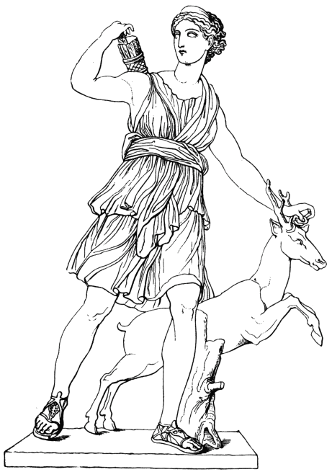
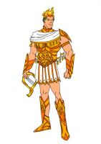
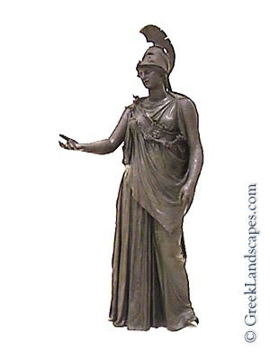
pg. 475
Have you heard the song “ Bohemian Rhapsody” by Queen? It emulates the tradition of the Greek chorus in which two groups sing back and forth.
Recall from Cornell notes your terms: Strophe & Antistrophe
The chorus will dance to the right or left, taking turns as they sing.
Review: What are roles of the chorus?
To represent the community or citizens
To serve as a measure of public opinion
To remind the audience that the outcome of the hero will impact society.
What does Pytho mean?
The chorus is praying to these 3 gods to protect them from death: _______________.
Insert images of these gods and delete my directions. ☺

Slide 2
In lines 234-236, what aspects of his life story does Oedipus’ description of himself emphasize?
This is an example of ________________ irony.
Which kind?
Situational—The opposite of what you expect happens.
Dramatic—The audience knows something that the characters do not. This builds suspense.
Verbal--sarcasm

Slide 3
Oedipus decides to find the murderer of Laius (pg. 285). How does this contribute to his role as a tragic hero?
Who is Teiresias?
What do we know about him?
Describe Oedipus’ tones when he addresses Teiresias (lines 322-340)
Insert an image of a wise person and a second image of blindness.

Slide 4
Enrichment: Teiresias
According to one legend, during his youth, Teiresias came upon a male and a female snake on Mount Cithaeron, near Thebes. He struck them with his staff, killing the female. Immediately, Teiresias was transformed into a woman. Some time later, he came upon another pair of snakes. This time, he killed the male.
In another legend, Zeus and Hera were arguing whether men or women are more capable of enjoying physical pleasure. They called on Teiresias to resolve the dispute because he had been both male and female during his life. Teiresias answered that the pleasure is greater for women. Infuriated, Hera blinded him on the spot, while Zeus rewarded him with the gift of prophecy.
In yet another legend, Teiresias accidently caught sight of Athena bathing and was struck blind. But, because Teiresias’ mother, Chariclo, was Athena’s favorite nymph, the goddess gave him the gift of prophecy and long life in place of his sight.
What do the “versions” that explain the oracle show you about Greek mythology?
Insert images of a snake, a fairy, and something to help predict the future

Slide 5
Insert an image of anger, frustration, or temper
List three phrases that show strong emotional connotations. (This is drama, after all.)
Example: “You’d_______us” (line 349).
“You would ___________ us and __________ the city” (line 362).
“I will not bring this _________ upon us both” (line 363).
“How ______________ you started up this taunt!” (391).
Why is Oedipus upset with Teiresias (lines 380-386)?
Notice another example of his tragic flaw!

Slide 6
Paraphrase
“I say that with those you love best you live foulest shame unconsciously and do not see where you are in calamity” (lines 410-412).
Who says this?
What does he mean?
In Greek, this phrase, those you love best, refers to:
Those who are your closest kin
Most trusted allies
Dearest friends
Most beloved (spouse)
Insert an image of heartbreak or family drama

Slide 7
The Oracle’s Validity
Insert an image to symbolize wisdom
Sophia is the Goddess of ______________________. The Sophists were the first paid professional teachers in Athens.
Protagoras said, “Man is the measure of all things.”
Antiphon said prophecy is “the guess of an intelligent man.”
Euripedes’ character Helen states, “The best prophet is intelligence and good counsel.”
How do Sophist beliefs relate to the role of the Oracle?
How is this debate reflected in Oedipus’ response to Teiresias when he learns the truth about his past?

Slide 8
What is the most infuriating thing someone can say or believe about who you are? For instance, I would be extremely upset if someone were to accuse me of not being faithful to my husband.
Where do you stand on the debate between intelligent predictions and people who claim to see the future?
Did you know that there’s a “seer” in the Old Testament whom King David goes to speak with? What’s the name? Mediums are forbidden and illegal, punishable by death, another opposition to distinguish Christianity from Greek pagan beliefs. (Google is your friend.)

Slide 9
Pg. 484
Insert a picture that shows one’s identity
In Line 495, Oedipus does not ask, “My parents?” but rather, “What parents?”
How does this one small difference in word choice change the meaning?
Now Teiresias is paralleling how Oedipus described himself earlier in lines 512-515. What’s the difference?

Slide 10
Amphitheaters
Insert an image of an amphitheater
Definition: open-air structure built expressly for public performances.
Amphi – on both sides / around
Proscenium- front of the stage
Parados— a corridor on the side where the chorus will enter
What is the current name of an amphitheater in North Carolina, and where is it located?

